Slide 1
Temporal Fusion Transformers for Interpretable Multi-horizon Time Series Forecasting
International Journal of Forecasting, 2021
Cited by 1742
Bryan Lima, Sercan O. Arkb, Nicolas Loeb, Tomas Psterb
University of Oxford, UK
Google Cloud AI, USA

Slide 2
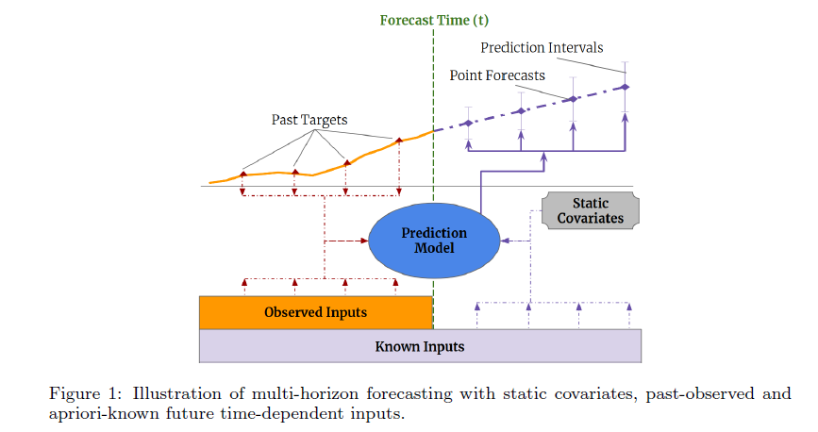
Motivations
Static covariates refer to features that remain constant over time and are used to provide additional context or information about the system being modeled.
Little information about data sources and their interactions makes multi-horizon time series forecasting particularly challenging, especially when we have exogenous time series.
Most current architectures are `black-box' models where complex nonlinear interactions between many parameters control forecasts. This makes it difficult to explain how models arrive at their predictions.
Attention-based architectures like the Transformer offer inherent interpretability for sequential data, such as language and speech. However, applying them to multi-horizon forecasting is challenging due to the diverse types of input features involved. While these architectures can highlight relevant time steps, they fail to differentiate the importance of various features at a specific time step.

Slide 3
Novelty
This paper introduces the Temporal Fusion Transformer (TFT), an attention-based deep neural network designed for high-performance multi-horizon forecasting with enhanced interpretability. TFT incorporates several novel features:
Static covariate encoders for context encoding.
Gating mechanisms and sample-dependent variable selection to reduce irrelevant input contributions.
A sequence-to-sequence layer for local input processing.
A temporal self-attention decoder to capture long-term dependencies.
Additional:
Gating mechanisms: Minimized the contribution of irrelevant input.
Sequence to sequence: locally processed and observed inputs (A model that contains encoder and decoder.)
Self-attention: long-term time dependencies

Slide 4
Related Work
DNNs for Multi-horizon Forecasting.
Time Series Interpretability with Attention: Attention mechanisms are used in translation, image classification, or tabular learning to identify salient input portions for each instance (sample) using the magnitude of attention weights.
Instance-wise (sample-wise) Variable Importance with DNNs: Post-hoc explanation methods, e.g. LIME, SHAP and RL-LIM.

Slide 5
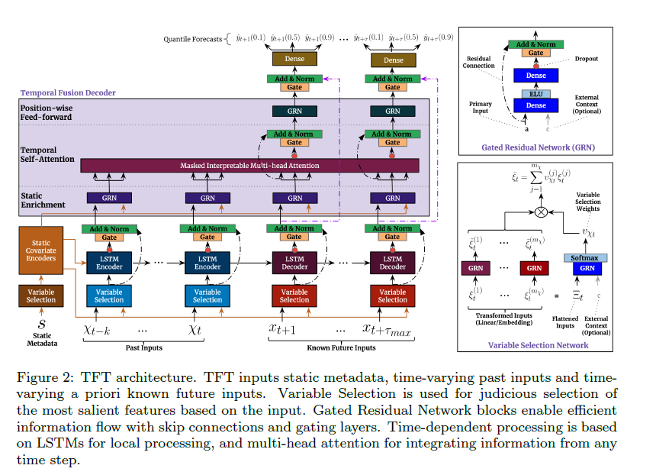
Model Architecture
Enhances temporal features with static metadata
Locality Enhancement with Seq-to-seq Layer

Slide 6
Model components
TFT is designed to efficiently build feature representations for each input type (i.e. static, known, observed inputs) for high forecasting performance on a wide range of problems.
1. Gating mechanisms to skip over any unused components of the architecture, providing adaptive depth and network complexity to accommodate a wide range of datasets and scenarios.
2. Variable selection networks to select relevant input variables at each time step.
3. Static covariate encoders to integrate static features into the network, through encoding of context vectors to condition temporal dynamics.
4. Temporal processing to learn both long- and short-term temporal relationships from both observed and known time-varying inputs. A sequence-to-sequence layer is employed for local processing, whereas long-term dependencies are captured using a novel interpretable multi-head attention block.

Slide 7
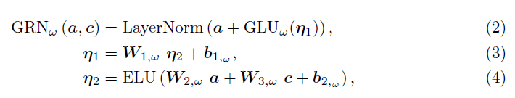
Gated Residual Network (GRN) and Gated Linear Units (GLUs)
Gated Residual Network (GRN) are used for the flexibility to apply non-linear processing only where needed.
Gated Linear Units (GLUs) are used to provide the flexibility to suppress any parts of the architecture that are not required for a given dataset.

Slide 8




Variable Selection Networks
By using this step, the method provides instance-wise variable selection through the use of variable selection networks applied to both static covariates and time-dependent covariates.
This method not only provides the most significant instance for the prediction problem but also removes unnecessary noisy inputs that could negatively impact performance.
It uses entity embeddings for categorical variables as feature representations, and linear transformations.
Let denote the transformed input of the j-th variable at time t, with being the flattened vector of all past inputs at time t.
$C_{s}$ is static covariate encoder

Slide 9


Variable Selection Networks
At each time stamps pass to the GRN:
And then combined the variables selection steps:

Slide 10
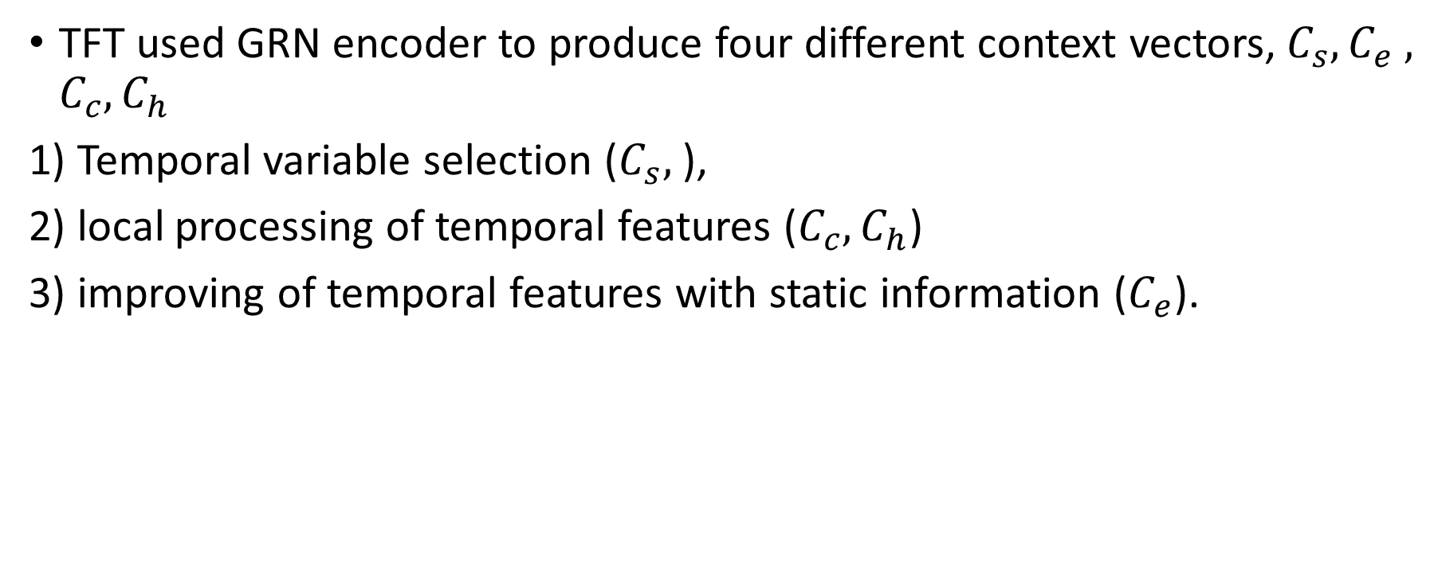
Static Covariate Encoders
TFT used GRN encoder to produce four different context vectors,${ C}_{s}, C_{e} ,$ $C_{c},C_{h}$
1) Temporal variable selection ($C_{s},$),
2) local processing of temporal features ($C_{c},C_{h}$)
3) improving of temporal features with static information ($C_{e}$).

Slide 11



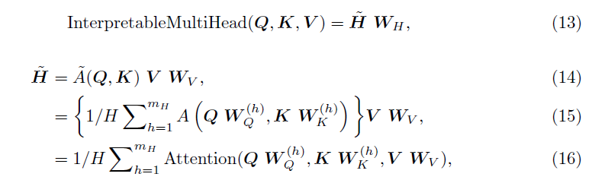
Interpretable Multi-Head Attention
Transformer based attention:
The standard Multi head attention is represented as follows:
In this paper, they modify multi-head attention to share values in each head and employ additive aggregation of all heads.

Slide 12

Locality Enhancement with Sequence-to-Sequence Layer
Conv layer for extracting local patterns in time series data is not good. So, it proposed a seq-to-sep model using LSTM. The data are passed to the encoder and decoder.
It employs a gated skip connection over the encoder and decoder layers:

Slide 13

Static Enrichment Layer
They proposed a static enrichment layer that enhances temporal features with static metadata. For a given position index n, static enrichment takes the form:

Slide 14


Temporal Self-Attention Layer
All static-enriched temporal features are first grouped into a single matrix, then interpretable multi head attention is applied:
Following the self-attention layer, an additional gating layer is also applied to facilitate training:

Slide 15

Position-wise Feed-forward Layer
They applied an additional non-linear processing to the outputs of the self-attention layer.

Slide 16

Outputs
forecasts values are generated using a linear transformation of the output from the temporal fusion decoder.

Slide 17
Result
The model's performance is evaluated on:
Electricity and Traffic datasets –more straightforward univariate time series with known inputs alongside the target.
Retail dataset – showcasing the model's ability to handle complex inputs typical of multi-horizon prediction applications.

Slide 18
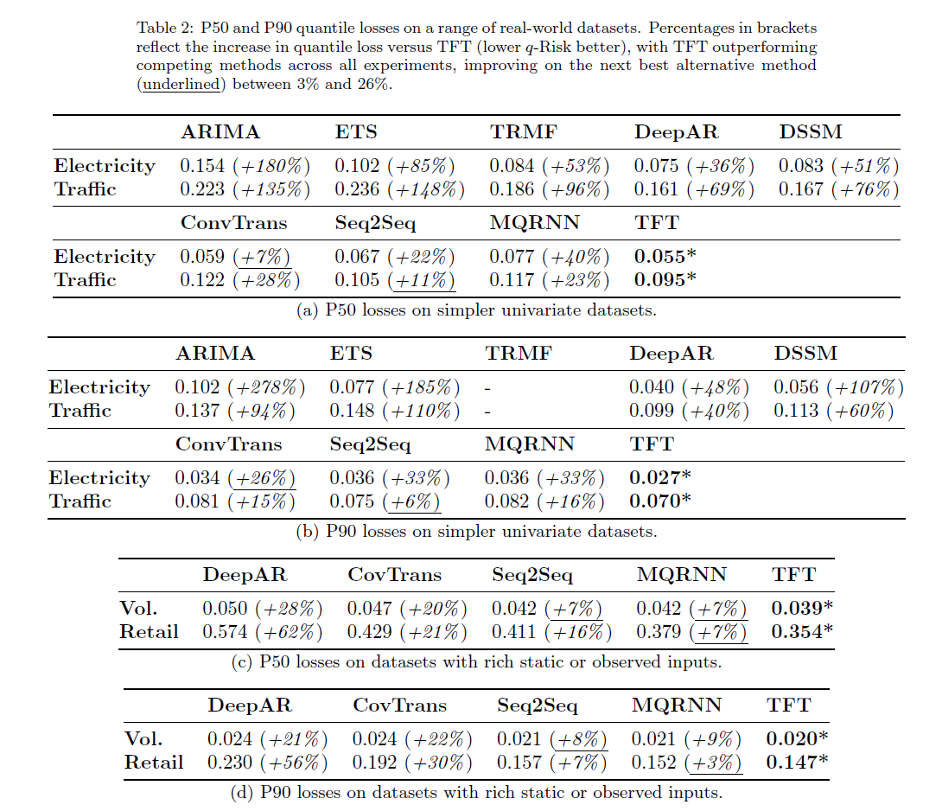

Slide 19
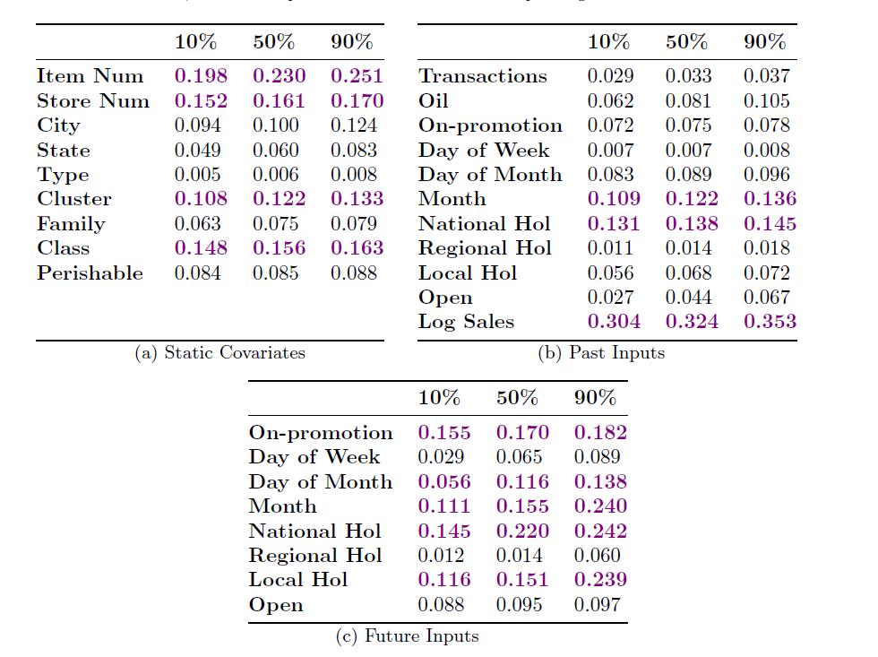
Analyzing Variable Importance
By aggregating selection weights (i.e. $v_{Xt}^{(j)}$) for each variable across our entire test set in Retail dataset

Slide 20
